Slide 1
Decorator

Slide 2
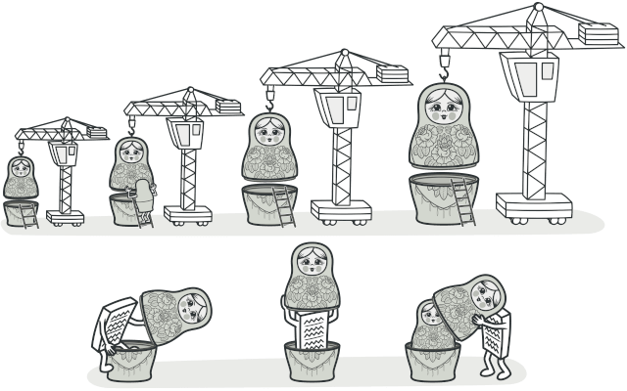
What is?
Decorator is a structural design pattern that lets you attach new behaviors to objects by placing these objects inside special wrapper objects that contain the behaviors.

